Slide 1
Reference Models

Slide 2
Communication Architecture
Strategy for connecting host computers and other communicating equipment.
Defines necessary elements for data communication between devices.
A communication architecture, therefore, defines a standard for the communicating hosts.
A programmer formats data in a manner defined by the communication architecture and passes it onto the communication software.
Separating communication functions adds flexibility, for example, we do not need to modify the entire host software to include more communication devices.

Slide 3
Layer Architecture
Layer architecture simplifies the network design.
It is easy to debug network applications in a layered architecture network.
The network management is easier due to the layered architecture.
Network layers follow a set of rules, called protocol.
The protocol defines the format of the data being exchanged, and the control and timing for the hand shake between layers

Slide 4
Reference model
A reference model—in systems, enterprise, and software engineering
is an abstract framework or domain-specific ontology consisting of an interlinked set of clearly defined concepts produced by an expert or body of experts to encourage clear communication.
A reference model can represent the component parts of any consistent idea, from business functions to system components, as long as it represents a complete set.
This frame of reference can then be used to communicate ideas clearly among members of the same community.

Slide 5
In computer networks, reference models give a conceptual framework that standardizes communication between heterogeneous networks.
Two popular reference models are
  OSI Model
  TCP/IP Protocol Suite

Slide 6
OSI Model
Open System Interconnection is a reference model that describes how information from a software application in one computer moves through a physical medium to the software application in another computer.
It consists of seven layers, and each layer performs a particular network function.
It was developed by the International Organization for Standardization (ISO) in 1984, and it is now considered as an architectural model for the inter-computer communications.
It divides the whole task into seven smaller and manageable tasks.
Each layer is assigned a particular task. Each layer is self-contained, so that task assigned to each layer can be performed independently.

Slide 7
Characteristics of OSI Model
The OSI model layers are grouped into two layers:
upper layers and lower layers.

Slide 8
Upper layer:
  The upper layer of the OSI model mainly deals with the application related issues, and they are implemented only in the software.
  The application layer is closest to the end user.
  Both the end user and the application layer interact with the software applications.
Lower layer:
  The lower layer of the OSI model deals with the data transport issues. The data link layer and the physical layer are implemented in hardware and software.
  The physical layer is the lowest layer of the OSI model and is closest to the physical medium.
  The physical layer is mainly responsible for placing the information on the physical medium.

Slide 9
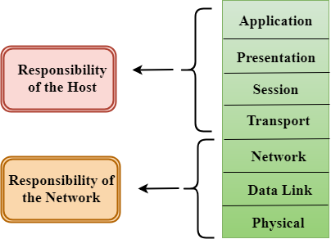

Slide 10
The OSI Reference Model
Principles for the seven layers
  Layers created for different abstractions
  Each layer performs well-defined function
  Function of layer chosen with definition of international standard protocols in mind
  Minimize information flow across interfaces between boundaries
  Number of layers optimum

Slide 11
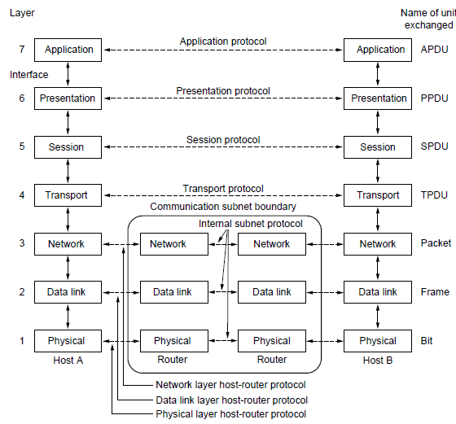
The OSI Reference Model

Slide 12
SEVEN LAYERS OF OSI REFERENCE MODEL
Physical layer – provides a physical medium through which bits are transmitted
Data link layer – used for error free transfer of data frames
Network layer – responsible for moving the packets from source to the destination
Transport layer – provides reliable message delivery from process to process
Session layer – used to establish, manage, and terminate the sessions
Presentation layer – responsible for translation, compression and encryption
Application layer – provides the services to the user

Slide 13
1. Physical Layer
Physical layer is the bottom layer of the OSI reference model.
The main functionality of the physical layer is to transmit the individual bits from one node to another node.
It establishes, maintains and deactivates the physical connection.
It specifies the mechanical, electrical and procedural network interface specifications.

Slide 14
The physical layer has four important characteristics.
Mechanical. Relates to the physical properties of the interface to a transmission medium. Typically, the specification is of a pluggable connector that joins one or more signal conductors, called circuits.
Electrical. Relates to the representation of bits (e.g., in terms of voltage levels) and the data transmission rate of bits. It defines the voltage, current, modulation, bit synchronization, connection activation and deactivation, and various electrical characteristics for the transmission media (such as unshielded or shielded twisted-pair cabling, coaxial cabling, and fiber-optic cabling).
Functional. Specifies the functions performed by individual circuits of the physical interface between a system and the transmission medium.
Procedural. Specifies the sequence of events by which bit streams are exchanged across the physical medium.

Slide 15
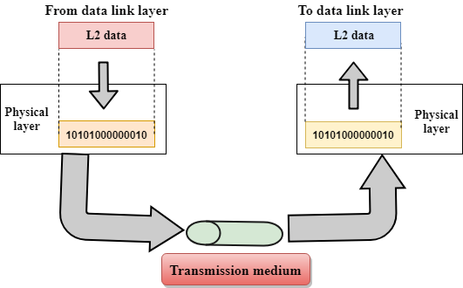

Slide 16
Functions of a Physical layer:
Line Configuration: It defines the way how two or more devices can be connected physically.
Data Transmission: It defines the transmission mode whether it is simplex, half-duplex or full-duplex mode between the two devices on the network.
Topology: It defines the way how network devices are arranged.
Signals: It determines the type of the signal used for transmitting the information.

Slide 17
2. Data Link Layer
The physical layer provides only a raw bit-stream service, the data link layer attempts to make the physical link reliable while providing the means to activate, maintain, and deactivate the link .
This layer is responsible for the error-free transfer of data frames.
It defines the format of the data on the network.
It provides a reliable and efficient communication between two or more devices.
It is mainly responsible for the unique identification of each device that resides on a local network.

Slide 18
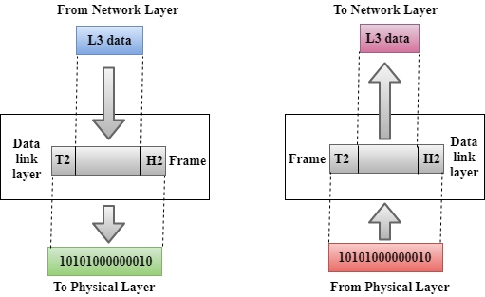

Slide 19
For LANs, the Project 802 standards of the Institute of Electrical and Electronics Engineers (IEEE) separate the data-link layer into two sublayers:
  Logical Link Control Layer
  Media Access Control Layer

Slide 20
The logical link control (LLC) layer, the upper of the two layers, which is responsible for flow control, error correction, and resequencing functions for connection-oriented communication, but which also supports connectionless communication.
It is responsible for transferring the packets to the Network layer of the receiver that is receiving.
It identifies the address of the network layer protocol from the header.

Slide 21
The media access control (MAC) layer, the lower of the two layers, which is responsible for providing a method for stations to gain access to the medium.
A Media access control layer is a link between the Logical Link Control layer and the network's physical layer.
It is used for transferring the packets over the network.

Slide 22

Functions
Framing
The data link layer divides the stream of bits received from the network layer into manageable data units called frames i.e. it translates the physical's raw bit stream into packets known as Frames.
The Data link layer adds the header and trailer to the frame. The header which is added to the frame contains the hardware destination and source address.

Slide 23
Physical addressing
If frames are to be distributed to different systems on the network, the data link layer adds a header to the frame to define the sender and/or receiver of the frame.
If the frame is intended for a system outside the sender's network, the receiver address is the address of the device that connects the network to the next one.

Slide 24
Flow control
It is the main functionality of the Data-link layer. It is the technique through which the constant data rate is maintained on both the sides so that no data get corrupted.
It ensures that the transmitting station such as a server with higher processing speed does not exceed the receiving station, with lower processing speed. i.e., If the rate at which the data are absorbed by the receiver is less than the rate at which data are produced in the sender, the data link layer imposes a flow control mechanism to avoid overwhelming the receiver.

Slide 25
Error control
The data link layer adds reliability to the physical layer by adding mechanisms to detect and retransmit damaged or lost frames.
It also uses a mechanism to recognize duplicate frames.
Error control is achieved by adding a calculated value CRC (Cyclic Redundancy Check) that is placed to the Data link layer's trailer which is added to the message frame before it is sent to the physical layer. If any error seems to occur, then the receiver sends the acknowledgment for the retransmission of the corrupted frames.

Slide 26
Access control. When two or more devices are connected to the same link, data link layer protocols are necessary to determine which device has control over the link at any given time
Examples of data-link protocols for local area networking include the following:
IEEE 802.3, which provides the Carrier Sense Multiple Access with Collision Detection (CSMA/CD) access method for baseband Ethernet networks
IEEE 802.5, which provides the token-passing access method for baseband token ring implementations

Slide 27
For WANs, data-link layer protocols encapsulate LAN traffic into frames suitable for transmission over WAN links.
Common data-link encapsulation methods for WAN transmission include the following:
  Point-to-point technologies such as Point-to-Point Protocol (PPP) and High-level Data Link Control (HDLC) protocol
  Multipoint technologies such as frame relay, Asynchronous Transfer Mode (ATM), Switched Multimegabit Data Services (SMDS), and X.25

Slide 28
3. Network Layer
The network layer is responsible for functions such as the following:
Logical addressing and routing of packets over the network
Establishing and releasing connections and paths between two nodes on a network
Transferring data, generating and confirming receipts, and resetting connections

Slide 29
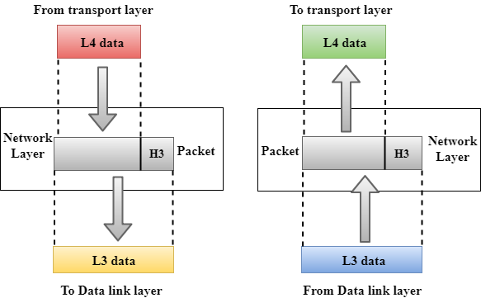

Slide 30
It manages device addressing, tracks the location of devices on the network.
It determines the best path to move data from source to the destination based on the network conditions, the priority of service, and other factors.
It is responsible for routing and forwarding the packets.
Routers are the layer 3 devices, they are specified in this layer and used to provide the routing services within an internetwork.
The protocols used to route the network traffic are known as Network layer protocols. Examples of protocols are IP and Ipv6.

Slide 31
The network layer also supplies connectionless and connection-oriented services to the transport layer above it.
The network layer functions closely with the physical layer (layer 1) and data-link layer (layer 2) in most real world network protocol implementations.
On TCP/IP-based networks, IP addresses and network numbers are used at the network layer, and IP routers perform their routing functions at this layer.
An example of an OSI model network layer protocol is the X.25 packet-switching network layer protocol, which is built on the X.21 physical layer protocol.

Slide 32
Functions of Network Layer:
Internetworking: An internetworking is the main responsibility of the network layer. It provides a logical connection between different devices.
Addressing: A Network layer adds the source and destination address to the header of the frame. Addressing is used to identify the device on the internet.
Routing: Routing is the major component of the network layer, and it determines the best optimal path out of the multiple paths from source to the destination.
Packetizing: A Network Layer receives the packets from the upper layer and converts them into packets. This process is known as Packetizing. It is achieved by internet protocol (IP).

Slide 33
4. Transport Layer
The Transport layer is a Layer 4 ensures that messages are transmitted in the order in which they are sent and there is no duplication of data.
The main responsibility of the transport layer is to transfer the data completely.
It receives the data from the upper layer and converts them into smaller units known as segments.
This layer can be termed as an end-to-end layer as it provides a point-to-point connection between source and destination to deliver the data reliably.

Slide 34
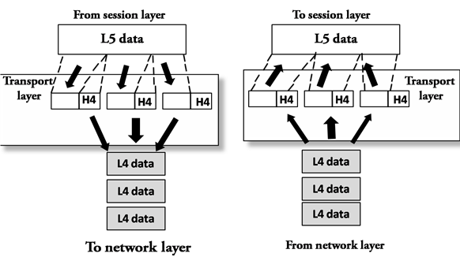

Slide 35
The transport layer is responsible for providing reliable transport services to the upper-layer protocols.
These services include the following:
Flow control to ensure that the transmitting device does not send more data than the receiving device can handle.
Packet sequencing for segmentation of data packets and remote reassembly.
Error handling and acknowledgments to ensure that data is retransmitted when required.
Multiplexing for combining data from several sources for transmission over one data path.
Virtual circuits for establishing sessions between communicating stations.

Slide 36
5. Session Layer
It enables sessions between computers on a network to be established and terminated.
The session layer does not concern itself with issues such as the reliability and efficiency of data transfer between stations because these functions are provided by the first four layers of the OSI reference model.

Slide 37
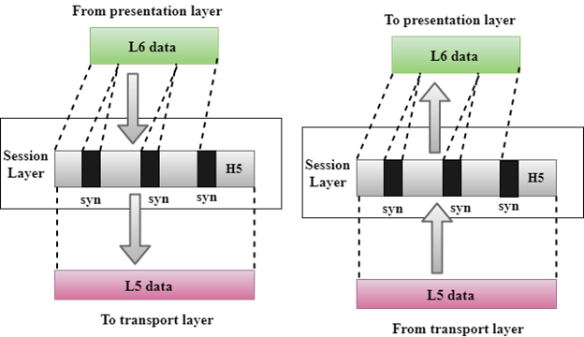

Slide 38
Functions:
Dialog control: The session layer allows two systems to enter into a dialog. It allows the communication between two processes to take place in either half- duplex (one way at a time) or full-duplex (two ways at a time) mode.
Synchronization: The session layer allows a process to add checkpoints, or synchronization points, to a stream of data.

Slide 39
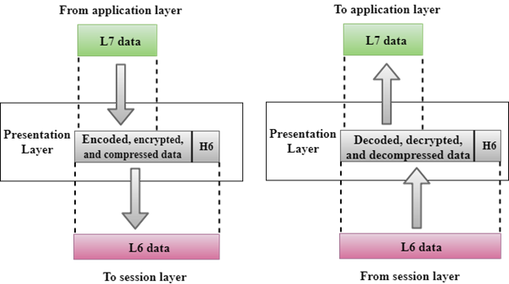
6. Presentation Layer

Slide 40
The presentation layer is concerned with the syntax and semantics of the information exchanged between two systems .
Specific responsibilities of the presentation layer include the following:
Translation. The processes (running programs) in two systems are usually exchanging information in the form of character strings, numbers, and so on. The information must be changed to bit streams before being transmitted.
Because different computers use different encoding systems, the presentation layer is responsible for interoperability between these different encoding methods.
The presentation layer at the sender changes the information from its sender-dependent format into a common format. The presentation layer at the receiving machine changes the common format into its receiver-dependent format.

Slide 41
Encryption. To carry sensitive information, a system must be able to ensure privacy. Encryption means that the sender transforms the original information to another form and sends the resulting message out over the network.
Decryption reverses the original process to transform the message back to its original form.
Compression. Data compression reduces the number of bits contained in the information. Data compression becomes particularly important in the transmission of multimedia such as text, audio, and video.

Slide 42
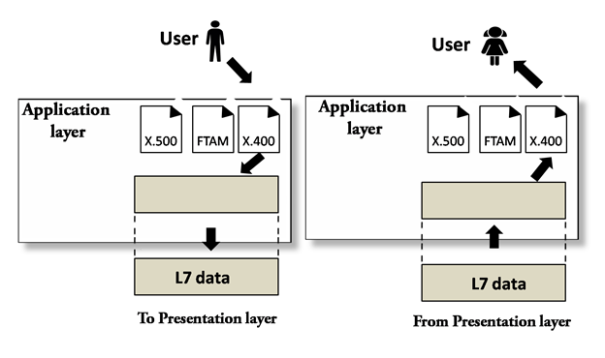
7. Application layer
Layer 7 of the Open Systems Interconnection (OSI) reference model, in which network-aware, user-controlled software is implemented—for example, e-mail, file transfer utilities, and terminal access. The application layer represents the window between the user and the network.

Slide 43
Examples of protocols that run at the application layer include File Transfer Protocol (FTP), Hypertext Transfer Protocol (HTTP), telnet, and similar protocols that can be implemented as utilities the user can interface with.
File transfer, access, and management. This application allows a user to access files in a remote host (to make changes or read data), to retrieve files from a remote computer for use in the local computer, and to manage or control files in a remote computer locally.
Mail services. This application provides the basis for e-mail forwarding and storage.
Directory services. This application provides distributed database sources and access for global information about various objects and services.

